Slide 1
BE ALERT: It’s Scam Season
FCC SCAM PREVENTION
WORKSHOP
Wednesday, November 10, 2021
2:00pm – 3:00pm

Slide 2
ROBOCALLS
What Are Robocalls?
Robocalls are calls made with an auto dialer or that contain a message made
with a prerecorded or artificial voice.
The Commission has tackled robocalls in many ways:
Issuing hundreds of millions of dollars in enforcement actions against
illegal robocallers.
Allowing phone companies to block by default illegal or unwanted calls based on reasonable call analytics before the calls reach consumers.
Educating consumer about options on tools to block calls from any number that doesn't appear on a customer's contact list.
Urging phone companies to implement caller ID authentication to help reduce
illegal spoofing.

Slide 3
SPOOFING: Don’t Hang On, Hang Up!
What is Spoofing?
Spoofing is when a caller deliberately falsifies the information transmitted to your caller ID display to disguise their identity. Scammers often use neighbor spoofing so it appears that an incoming call is coming from a local number or spoof a number from a company or a government agency that you may already know and trust. If you answer, they use scam scripts to try to steal your money or valuable personal information, which can be used in fraudulent activity.

Slide 4
IS SPOOFING ILLEGAL?
Spoofing someone else’s phone number is illegal WHEN it is done “with the intent to defraud, cause harm or wrongly obtain anything of value.”
Anyone who is illegally spoofing can face penalties of up to $10,000 for each violation.
The FCC extended this prohibition to text messages, calls originating from outside the United States to recipients within the United States, and additional types of voice calls, such as one-way VoIP calls.
Spoofing is not always illegal. There are legit , legal uses for spoofing, like when a doctor calls a patient from her personal mobile phone and displays the office number rather than the personal phone number or a business displays its toll-free call-back number.

Slide 6
KNOW YOUR SCAMS
What is a SCAM?
Types of SCAMS
A Fraudulent or Deceptive Act or Operation
To Deceive and Defraud (someone)
IRS Scam
Auto Warranty
‘Grandparent’
The FCC Scam Glossary describes robocall scams, spoofing scams and related consumer fraud, which the FCC tracks through complaints filed by consumers, news reports, and notices from other government agencies, consumer groups and industry sources.
Glossary entries include links to more detailed information posted in the Consumer Help Center and to trusted external sources.
Holiday Charity Scam
Medicaid Scam
Love and Happiness:
Romance Scam
One Ring
Phone Scam
Pet Scam
Social Security Scam
Fake Jury Duty Calls
COVID-19 Scams
Visit the FCC’s Scam Glossary at https://www.fcc.gov/scam-glossary
to see additional types of scams.

Slide 7
Communicating During an Emergency
Emergency Communications Tips:
Don’t Be Scared, Be PREPARED!
Communicating can be challenging during power outages caused by severe weather.
Learn how to prepare for such emergencies and what to do when outages occur.

Slide 8
FCC’s Consumer Resources
FCC Consumer Complaint Center consumercomplaints.fcc.gov/ 1-888-Call-FCC
For information about COVID-19 Scams visit www.fcc.gov/covid-scams
Information from the Consumer Affairs and Outreach Division is available at fcc.gov/outreach
Consumer Help Center
fcc.gov/consumers
Email: outreach@fcc.gov
To access consumer guides on various topics, visit the Consumer Help Center at www.fcc.gov/consumers

Slide 10
Emergency Broadband Benefit
What is the Benefit?
Who Is Eligible?
How Can Households Apply?

Slide 11
The Emergency Broadband Benefit Program is a Federal Communications Commission (FCC) Program that provides a temporary discount on monthly broadband bills for qualifying low-income households. Eligible households can receive:
Up to $50/month discount for broadband service and associated equipment rentals;
Up to $75/month discount for households on Tribal lands, and;
A one-time discount of up to $100 for a laptop, desktop computer, or tablet purchased through a participating provider.

Slide 12
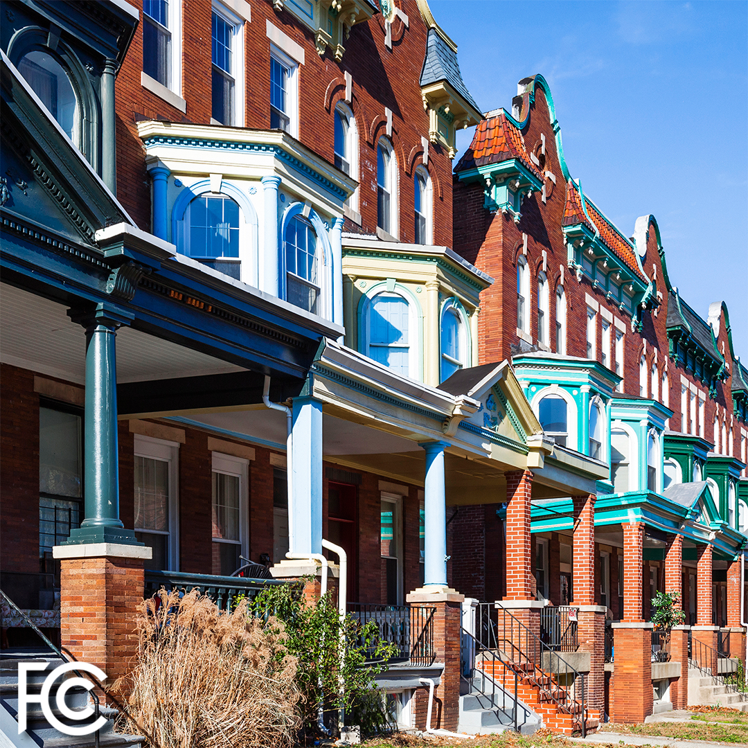
A Household is Eligible If Any Member
Received a Pell Grant in the current award year;
Is approved to receive benefits under the free and reduced school lunch program or school breakfast program in the 2019-2020, 2020-2021 or 2021-2022 school year;
Experienced a substantial loss of income, due to a job loss or furlough since 2/29/20 and the household had a total income in 2020 below $99,000 (single filers) or $198,000 (joint filers); or
Meets the eligibility of a participating providers’ existing COVID-19 or low-income program.

Slide 13
Households That Qualify for Lifeline Also Qualify
What is Lifeline?
Lifeline is a federal program that lowers the monthly cost of phone and internet. Eligible customers will get up to $9.25 (up to $34.25 on Tribal lands) toward their bill.
How Do I Qualify for Lifeline?
Household income is less than 135% of the Federal poverty guidelines
or
A member of the household participates in one of these programs:
Supplemental Nutrition Assistance Program (SNAP), formerly known as Food Stamps
Medicaid
Supplemental Security Income (SSI)
Federal Public Housing Assistance (FPHA)
Veterans Pension and Survivors Benefit
Tribal programs (and you live on qualifying Tribal lands)

Slide 14
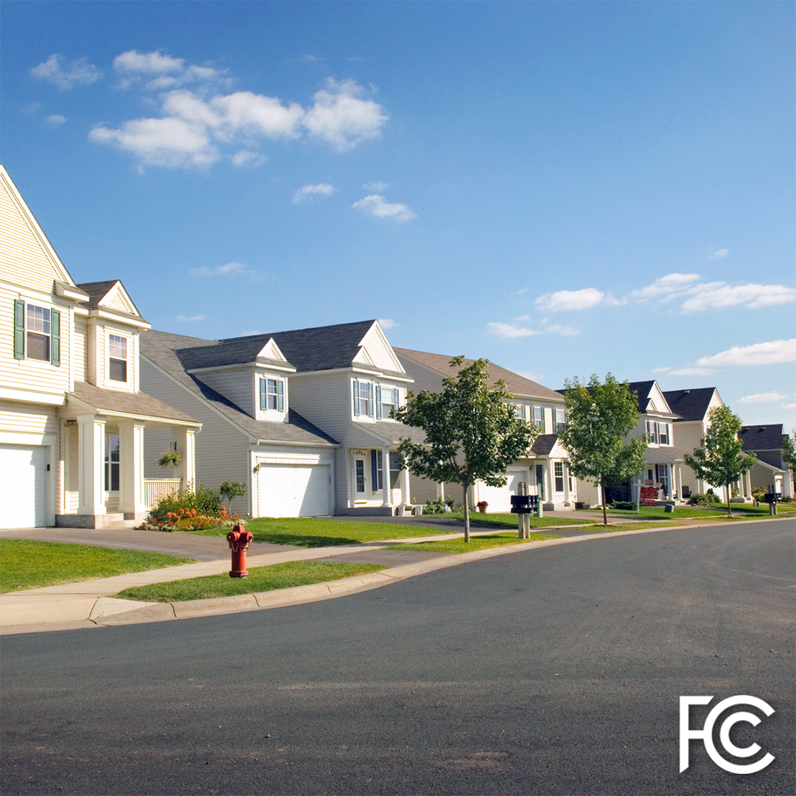
A household is a group of people who live together and share money (even if they are not related to each other.) If you live together and share money, you are one household. If you either don’t live together or you don’t share money, you are two or more households.
A household can qualify because of eligible dependent children that meet the eligibility criteria.
You may have to answer questions about your household when you apply for the Emergency Broadband Benefit Program.
A household worksheet will be available to assist in determining household eligibility.

Slide 15
When applying for the Emergency Broadband Benefit using USAC’s online application, they will attempt to confirm your information automatically.
Online and mail-in applicants may be asked to provide information or documentation to verify identity, address, or eligibility.
To confirm your eligibility, additional documentation can be mailed or submitted electronically. Examples of acceptable documents that can be used to validate information can be found at: www.getemergencybroadband.org/how-to-apply/show-you-qualify/

Slide 16
There are three ways to apply for the Emergency Broadband Benefit
Option 1: Contact a participating broadband provider directly to learn about their application process.
Option 2: Go to www.GetEmergencyBroadband.org
to apply online and to find participating providers near you.
Option 3: Send a mail-in application, along with proof of eligibility to: Emergency Broadband Support Center
P.O. Box 7081
London, KY 40742

Slide 17
The FCC’s EBB Consumer Hub:
www.fcc.gov/broadbandbenefit
USAC Toll free number for questions:
833-511-0311
To apply: www.GetEmergencyBroadband.org

