Slide 1
Rainforest Banners
in the style of
Henri Rousseau

Slide 2
Supply List:
Black permanent marker-Sharpie thin or thick point
White cloth banner or white paper
Colored markers
Acrylic paint (optional)
Tempera paint
Watercolor crayons (optional)
Press printing tools (objects to make marks when dipped into paint)
Popsicle stick, sponge, wooden dowel
Brush
Cup of water to wash off brush
paper plates to use for palette

Slide 3
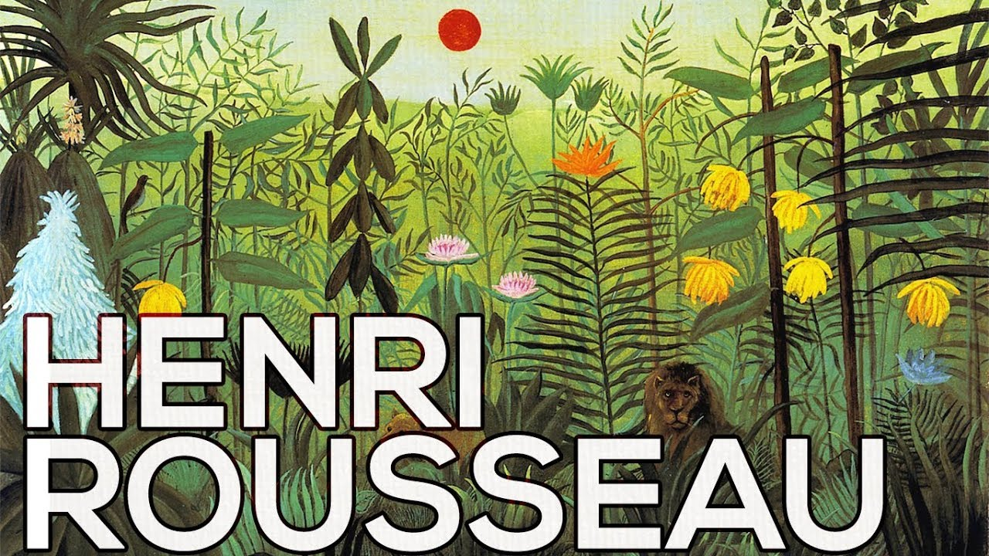
Henri Rousseau

Slide 4
Never went to a jungle or rainforest, only to the zoo. Used his imagination.

Slide 5
Henri Rousseau was born in Paris, France in 1874. Rousseau was a tax collector and toll taker. Painted after he retired. Became one of the world’s best-known artists.

Slide 10
Start your painting with five circles.

