Slide 1
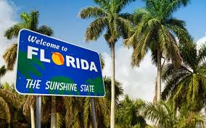

Weird Florida
Road Trip

Slide 2

Our Summer theme, “Imagine Your Story” takes us as far as our imagination can go. Florida has many weird and interesting places to visit that each have a unique story. Take a ride from South to North Florida and discover the unknown Florida tales.

Slide 3
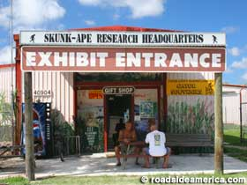
First Stop:
Skunk Ape
Research
Headquarters

Slide 4

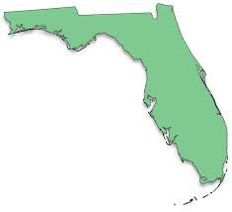
Ochopee

Slide 5
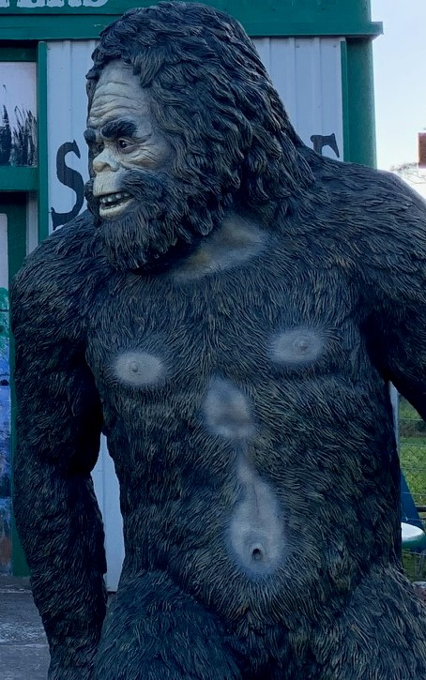
What is a Skunk Ape?
A skunk ape is claimed to be a version of Bigfoot.
This hairy and smelly creature is described as being well over six feet tall.
Early sightings have been reported by the Miccosukee and Seminole Indians.
Dave Shealy claims that he saw his first skunk ape in The Everglades in 1974 when he was ten.

Slide 6
Skunk Ape Research Headquarters
40904 Tamiami Trail E.
Ochopee, Fl
239-695-2275
Dave Shealy has been on various media outlets to showcase a 1997 picture of the skunk ape.
He has been researching this creature for over 30 years.
Tours of the everglades can be booked.
Officially licensed merchandise is also available for purchase in the shop.

Slide 7
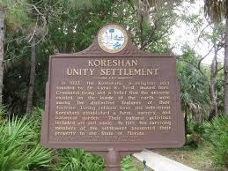
Next Stop: Koreshan State Park

Slide 8
Estero

Slide 9
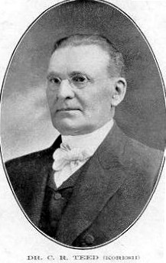
Cyrus Reed Teed
In 1896, Mr. Teed, an eclectic physician and alchemist, claimed divine intervention as a messiah. He then took on the name Koresh and proposed a religion called Koreshanity.
Koresh posited the Hollow Earth Theory which claimed the Earth to be a hollow sphere in which the land and sky reside.
Koresh established The Koreshan Unity commune in New York. He later brought his utopian settlement to Estero, Florida.

Slide 10
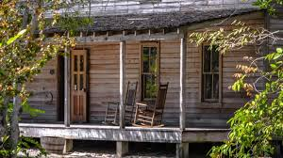
Cult or Utopia?
Many of Koresh’s followers left their husbands behind and pledged celibacy when arriving at the new settlement.
He believed celibacy led to immortality.
The Settlement had 250 members who built homes, an Arts Center, bakery, general store, power station, sawmill, and printing house.
Theatrical performances were frequently held. The arts were held in high esteem.

Slide 11
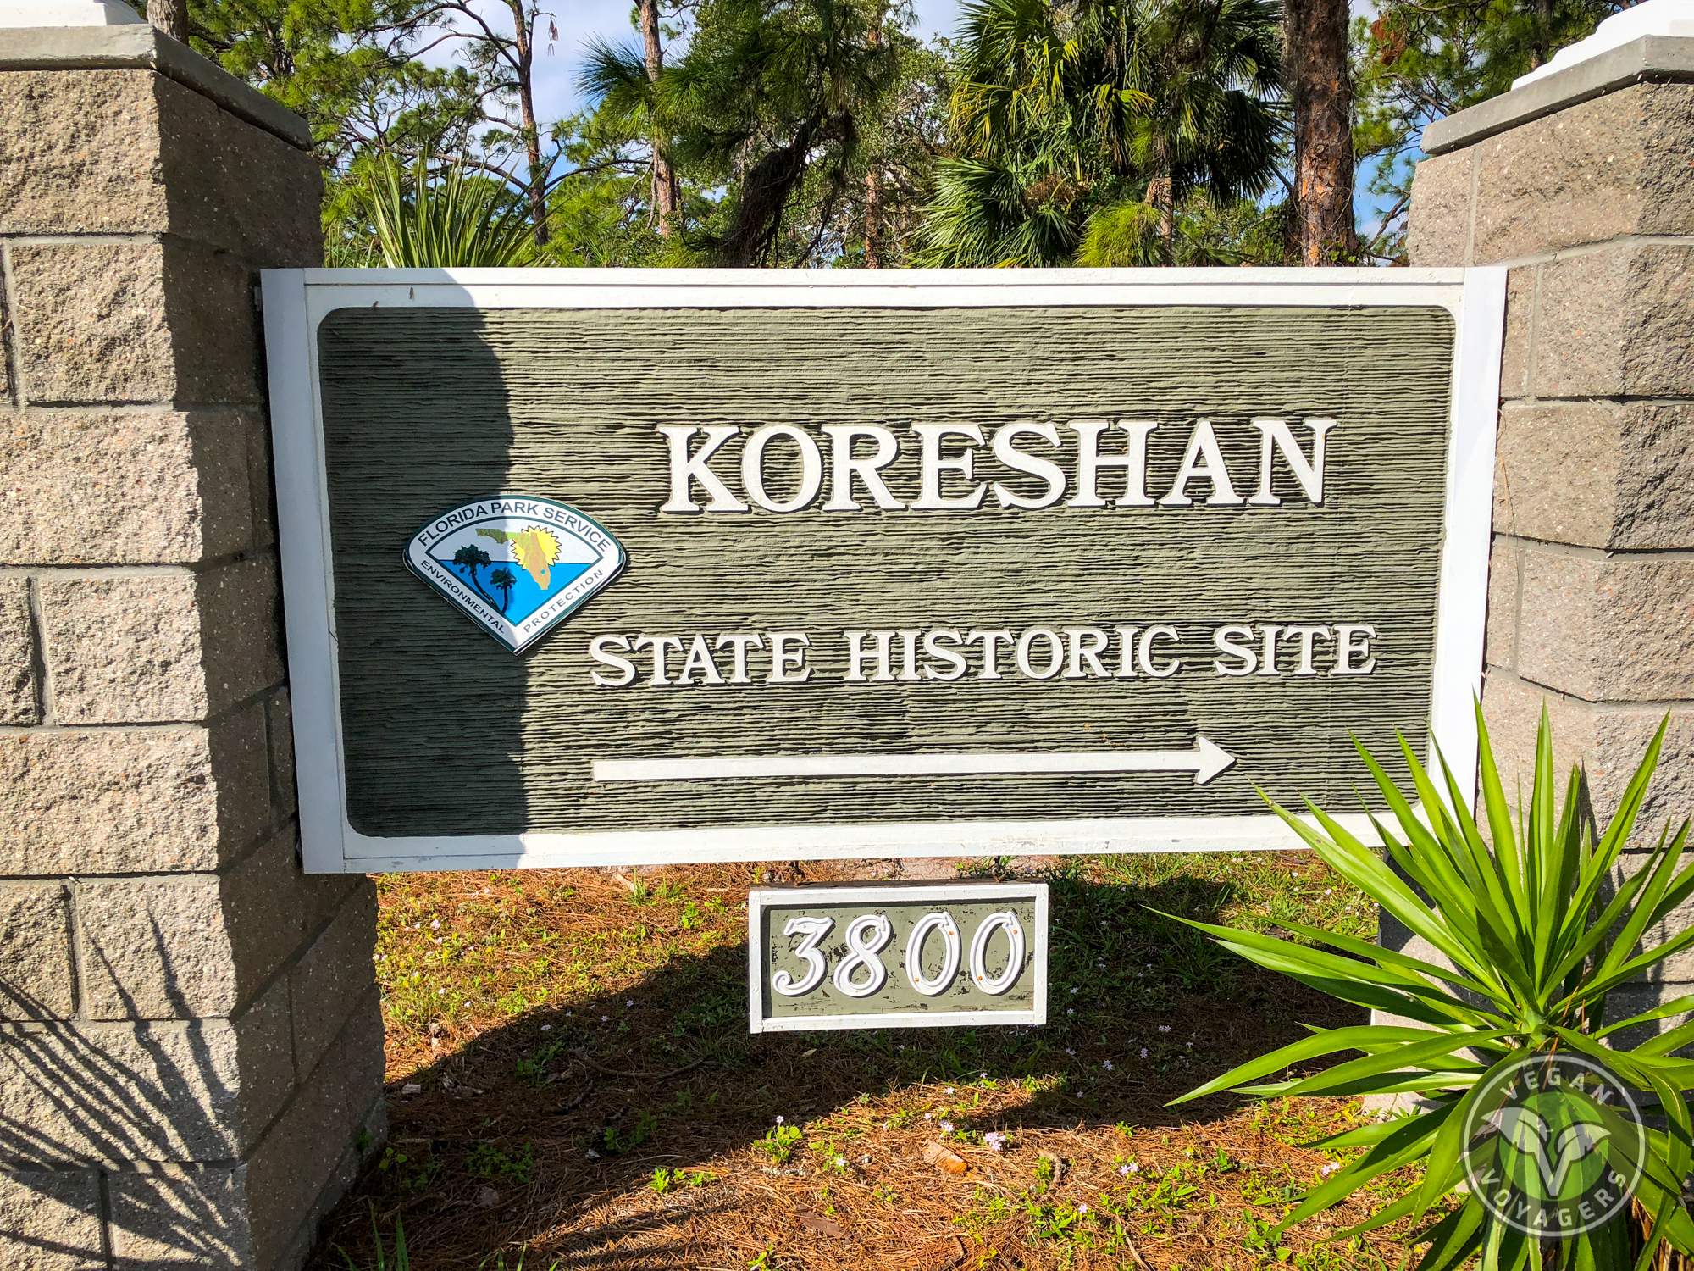
In 1908, Mr. Teed died. It was believed that his followers observed his body for five days for signs of immortality.
In 1961, the last remaining member of the settlement deeded the park to the Florida State Parks.
Visitors are welcome to take a tour of the life of these unique and industrious settlers.
3800 Corkscrew Road
Koreshan State Park
Estero, FL 33928
239-992-0311

Slide 12
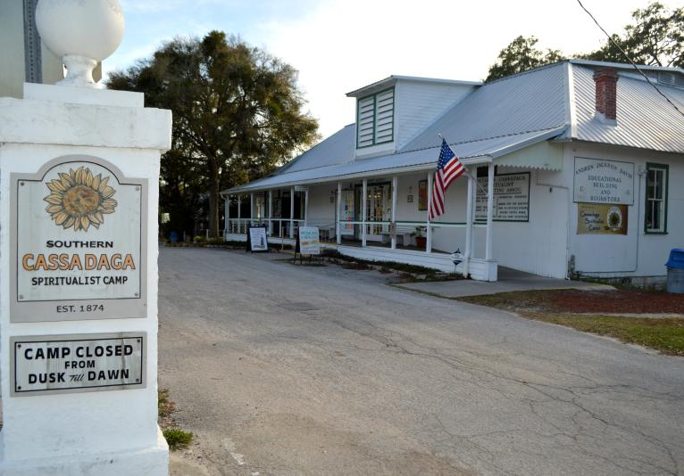
Buckle up! Off to: Cassadaga, Florida

Slide 13
Cassadaga

Slide 14
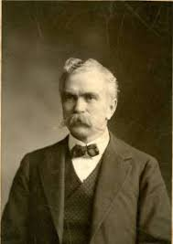
Cassadaga
In 1875, George Colby, a medium from Iowa, received a message from an Indian spirit. The spirit suggested that he contact another medium, T.D. Giddings from Wisconsin.
Through a series of sessions, they were instructed by a spirit guide to establish a spiritual center near Blue Springs, Florida.
It was to be set up ”on high pine hills, overlooking a chain of silvery lakes.”
They found this area which matched the description near the town of Lake Helen. Cassadaga became a spiritualist commune, hosting psychics and spiritualists throughout the world.

Slide 15
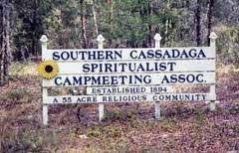
Cassadaga Spiritualist Camp
The Cassadaga Spiritualist camp features 57 acres. Many of the homes in the camp can be visited to receive patrons for healing or spiritual sessions.
The center welcomes seekers to self-explore and learn about the history.

Slide 16
Camp Cassadaga
Administrative Office
Hours: M-F, 9am - 5pm
​Closed for lunch 12pm - 1pm
Address: 1325 Stevens Street Cassadaga, FL 32706
Phone: 386-228-3171

Slide 17
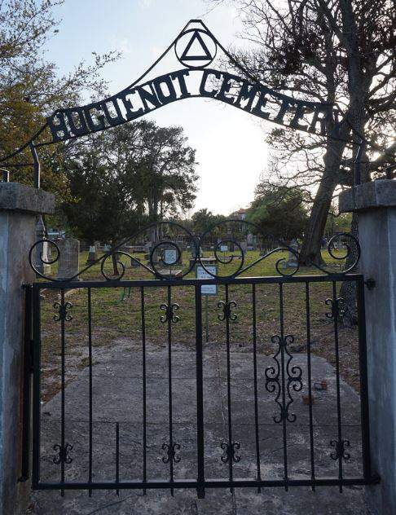
Buckle up for:
St. Augustine

Slide 18
St. Augustine

Slide 19
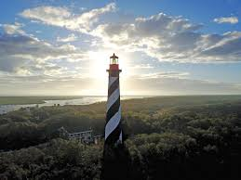
St. Augustine Lighthouse
Since 1876, the St. Augustine Lighthouse has been guiding ships into shore. It is the city’s oldest brick structure.
There have been historic tales of the drownings of the children and friend of an early superintendent of the lighthouse.
Paranormal activity, such as a shadowy figure and furniture moving, have been reported.
Ghost Hunters investigated and gathered evidence of paranormal activity which was featured on a couple of episodes.

Slide 20
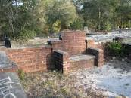
The Devil’s Chair
There is an urban legend that the chair built in the Lake Helen cemetery is The Devil’s Chair.
It is said that if you sit in the chair at midnight, the devil will talk to you.
Some claim that if you leave a full beer on the grave near the chair, it will be empty in the morning, but still sealed.

Slide 21

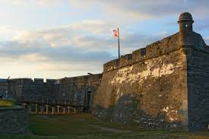
Castillo De SanMarco
*Built between 1672 -1756, this is the oldest existing
seacoast fort in the United States mainland.
*It was believed that the lower chamber of the fort was used
for torture during the Spanish Inquisition.
*It was believed that a Spanish officer suspected his wife to
be in a relationship with a handsome subordinate officer.
*The officer later reported to work smelling of the senior
officer’s wife’s perfume. The wife and the subordinate
officer went missing.
* In 1833, an American soldier discovered two skeletons
chained to the inside wall and when opened, a strong smell
of perfume emerged.

Slide 22
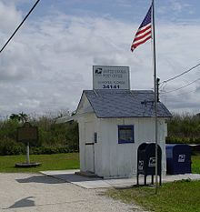
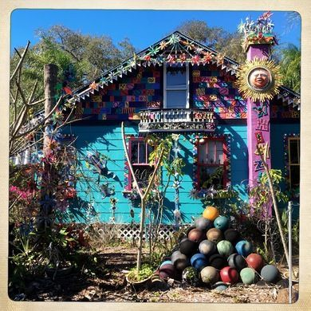
More places to visit….
The World’s Smallest Post Office, Ochopee
Coral Castle, Homestead
Whimzeyland (The Bowling Ball House) Safety harbor
Spook Hill, Lake Wales
Solomon’s Castle, Ona
The Bubble Room, Captiva
Florida Theater, Tampa
St. Francis Inn, St. Augustine
Many Ghost Tours, St. Augustine
Don CeSar, St. Pete Beach

